Slide 1
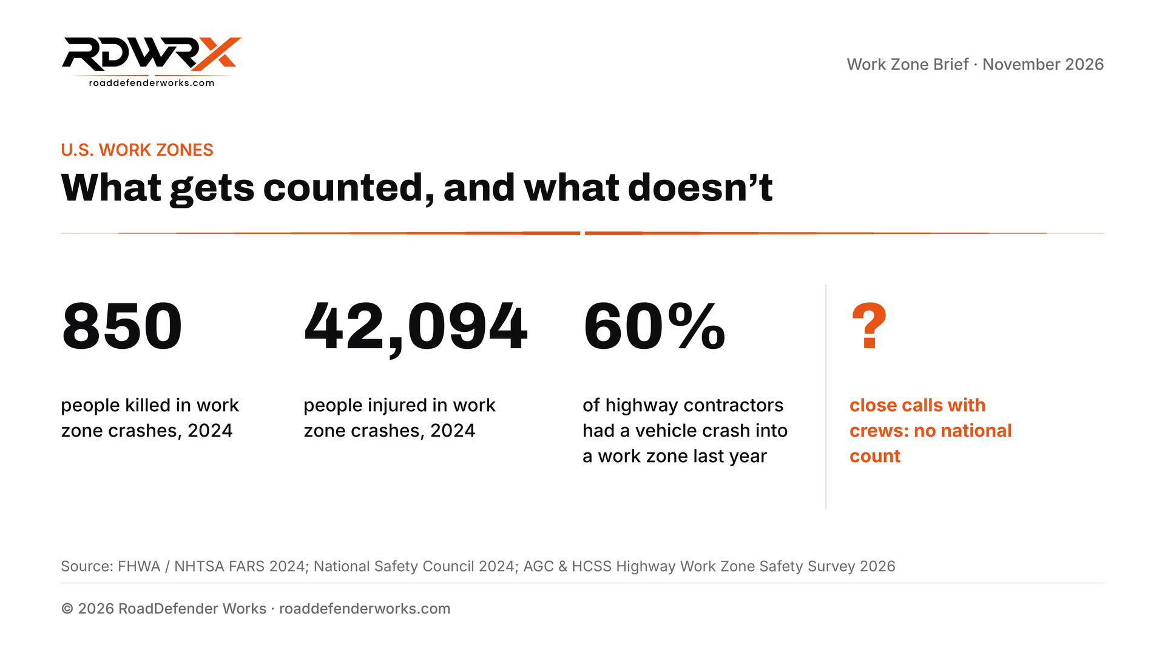
Notes:
Sources: FHWA / NHTSA FARS 2024 work zone facts (ops.fhwa.dot.gov); National Safety Council Injury Facts, Work Zones; AGC & HCSS Highway Work Zone Safety Survey 2026. Chart: Work Zone Brief, November 2026, RoadDefender Works (roaddefenderworks.com/brief).

Slide 2
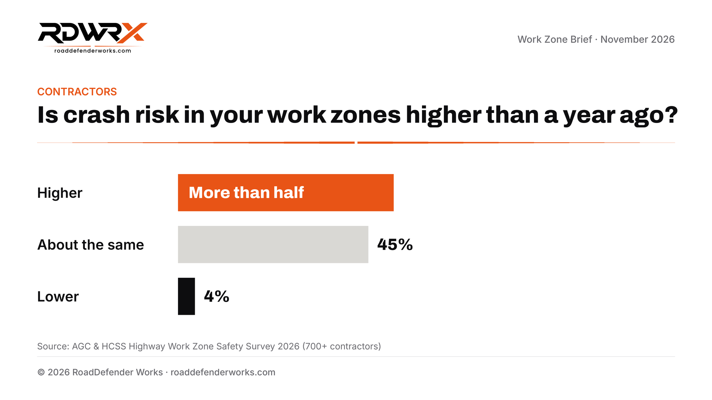
Notes:
Source: AGC & HCSS Highway Work Zone Safety Survey 2026, 700+ contractors (hcss.com). Chart: Work Zone Brief, November 2026, RoadDefender Works (roaddefenderworks.com/brief).

Slide 3
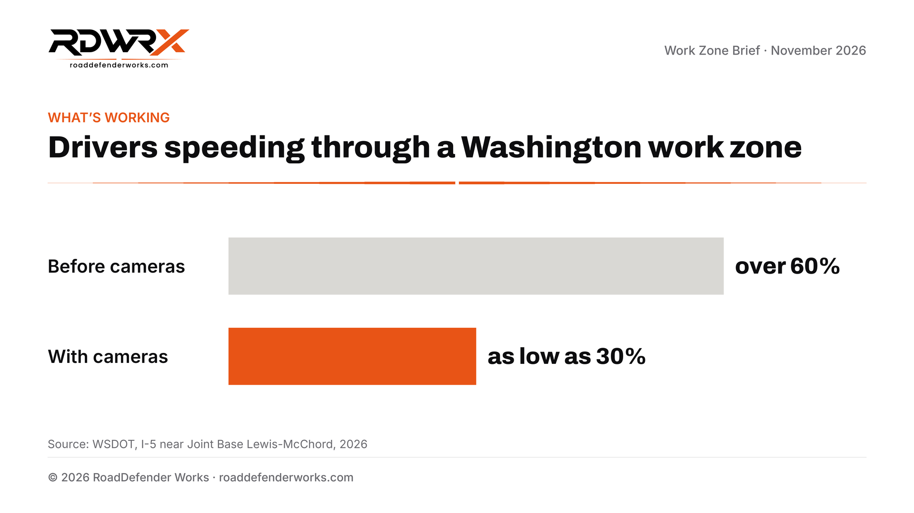
Notes:
Source: WSDOT, Work Zone Speed Camera Program, I-5 near Joint Base Lewis-McChord, April 2026 (wsdot.wa.gov). Chart: Work Zone Brief, November 2026, RoadDefender Works (roaddefenderworks.com/brief).

